Slide 1

ALUMNI ASSOCIATION
S.D. COLLEGE OF ENGINEERING & TECHNOLOGY
MUZAFFARNAGAR (UP)
BY PARUL GUTA
CO ORDINATOR

Slide 2
Purpose as per the Constitution
To actively promote interaction and networking among its alumni.
To be a pillar of support in their hour of need.
To help realize the notion of Giving Back to the Alma mater.
To function on a charitable basis, and to run the Association on ‘no profit-no loss’ basis’.
To contribute to the vision and strengthen the image of SDCET at national & international level
Organizing alumni reunions is an integral part of the Alumni Association of SDCET
Introduction
SDCET rising global recognition can be contributed to the stupendous work of its alumni. SDCET’s alumni are in every nook and corner of the world, spreading their mesmerizing aura through their notable achievements.
With more than 11500+ alumni spanning across the globe, SDCETr’s alumni have played a pivotal role in strengthening the image ofSDCETr.

Slide 3

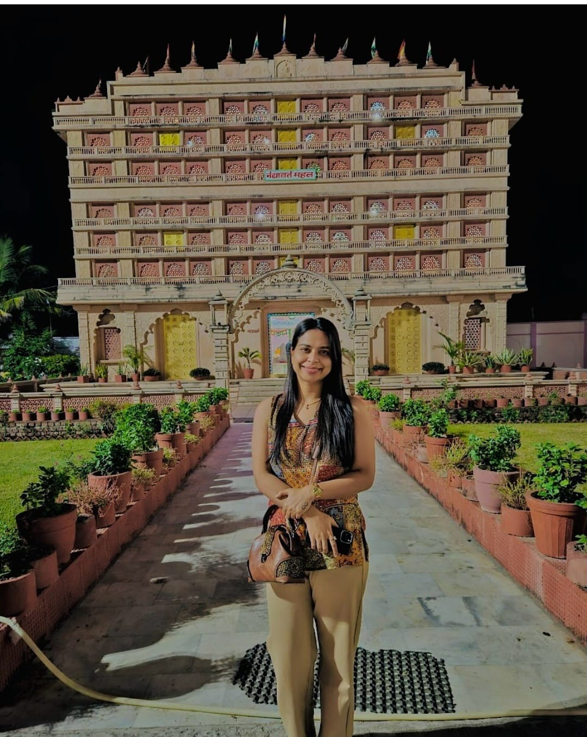
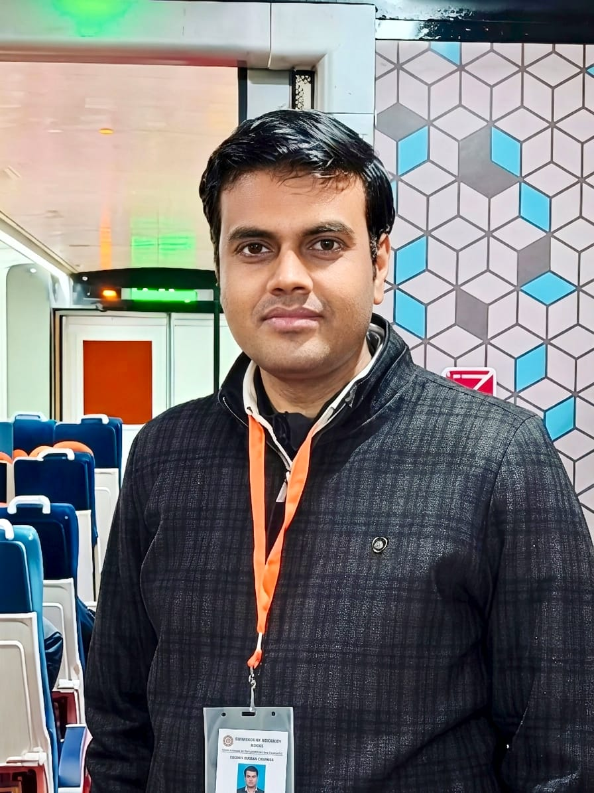
SANDHI JAIN (BT/CS/2018) is an Indian Defence Accounts Service (IDAS) officer of the 2021 batch. She cleared the Union Public Service Commission (UPSC) Civil Services Examination in 2020, securing All India Rank (AIR) 329, and subsequently joined the Controller General of Defence Accounts (CGDA) organization under the Ministry of Defence.
Alumni in focus
RAHUL SINGH (BT/EC/2007) is an IndianENGINEERINGService (IES) officer of the 2012 batch. He cleared theIndian Engineering Services (IES), officially called the Engineering Services Examination (ESE) conducted by UPSC,2012, securing All India Rank (AIR) 02, and subsequently joined the Chief Engineer in INDIAN RAILWAYS ,LUCKNOW

Slide 4

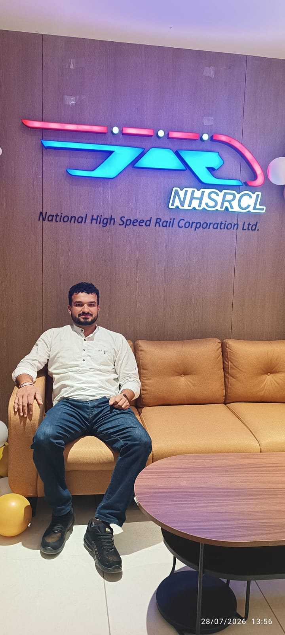
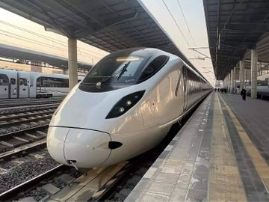
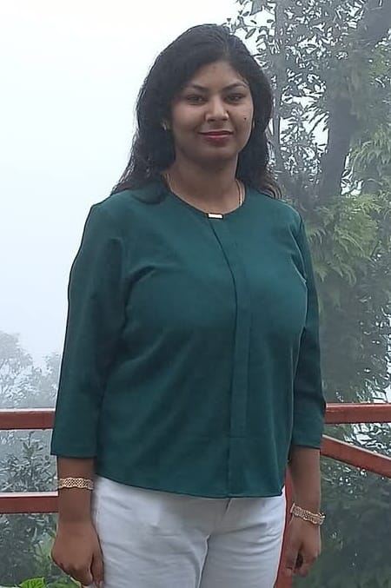
AAKASH (BT/EC/2015) have joined National High speed project ( Bullet train) in surat as a Integrated testing and commissioning engineer
Alumni in focus
Ms. Akanksha Goel (BT/CS/2018) ,
Additional District Informatics Officer
(ADIO), NIC Muzaffar Nagar

Slide 5
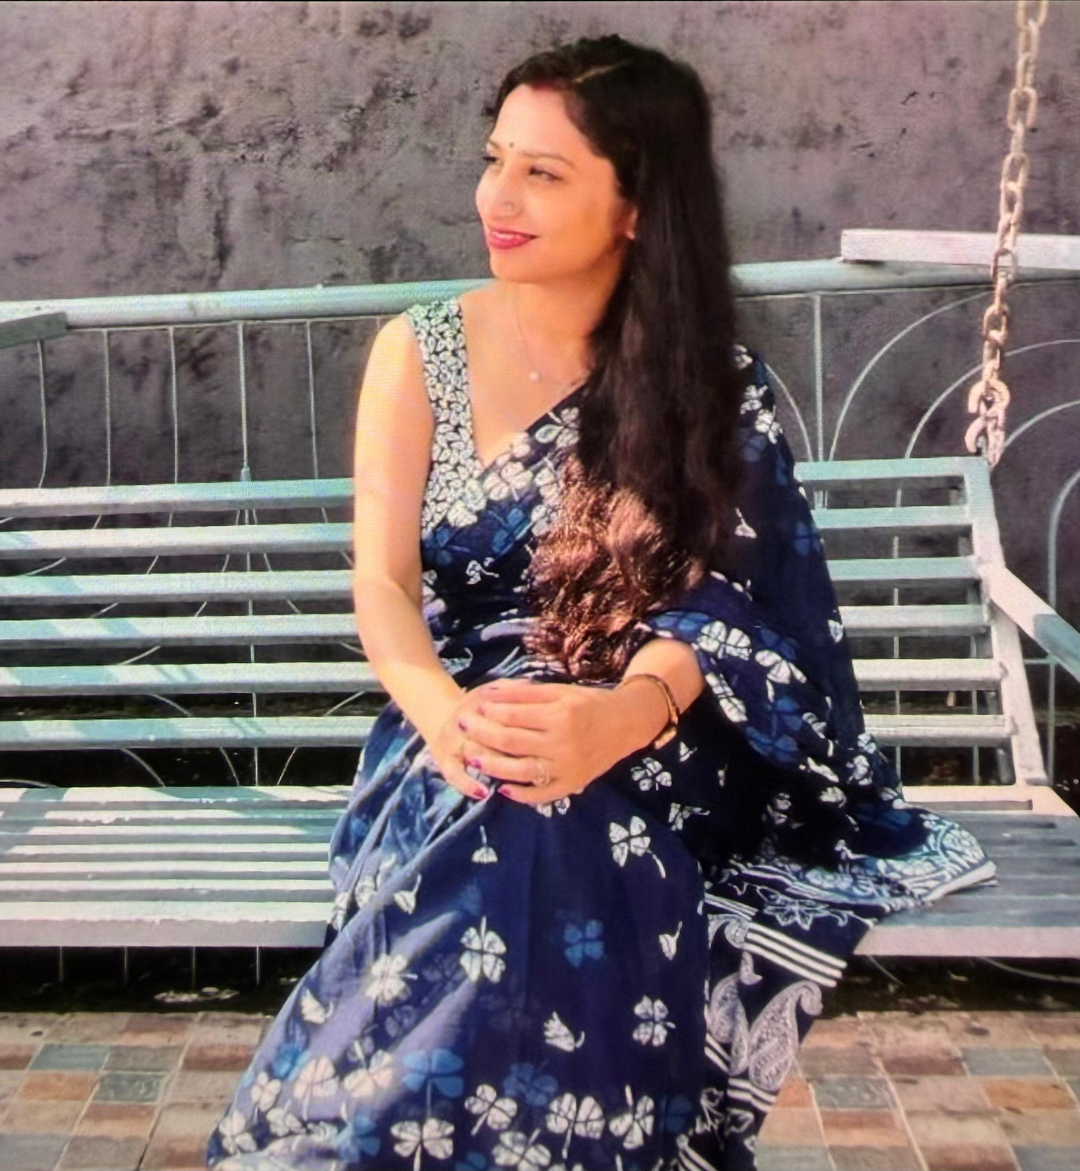

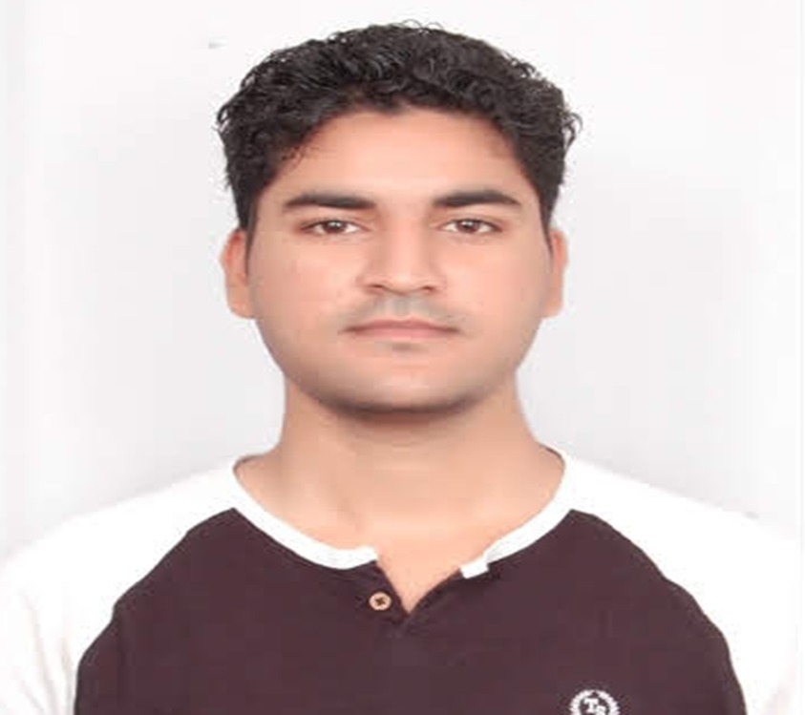
MEGHA SHARMA (BT/BT/2015)
QUALITY COTROL INSPECTOR
FOOD CORPORATION INDIA
TARUN DHIMAN (BT/EC/2021)
INDIAN INTELLIGENCE bureau
Alumni in focus

Slide 6

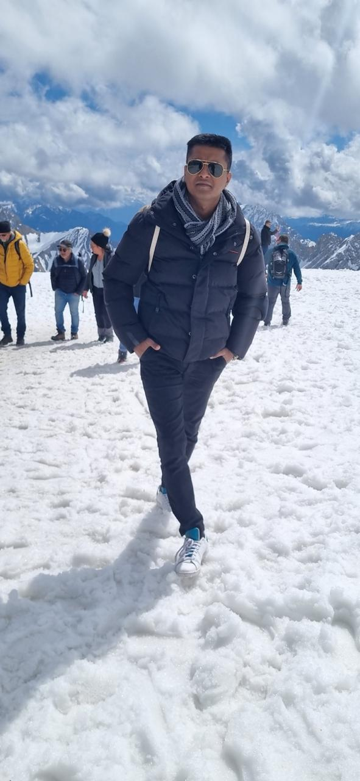
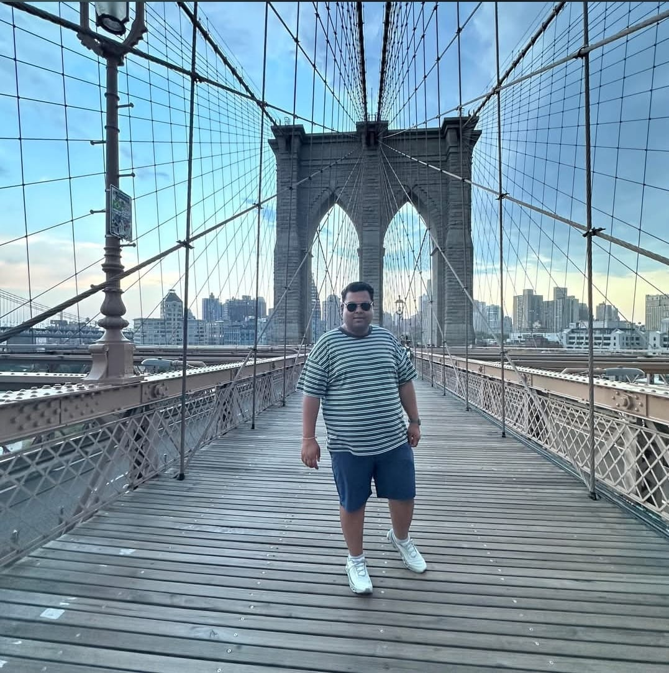
Young Rising Alumnus
ANSHUL GUPTA (BT/EC/2012)
Company Name - ASML
Designation- SENIOR SAP CONSULTANT
Location - Faridabad
Pass- out Year - 2012
MADHAV AGARWAL (BT/CS/2015) Company Name: TCS
Designation: Associate CONSULTANT
Location:MALVERN,PENNSYLVANIA
Pass-out year- 2015

Slide 7
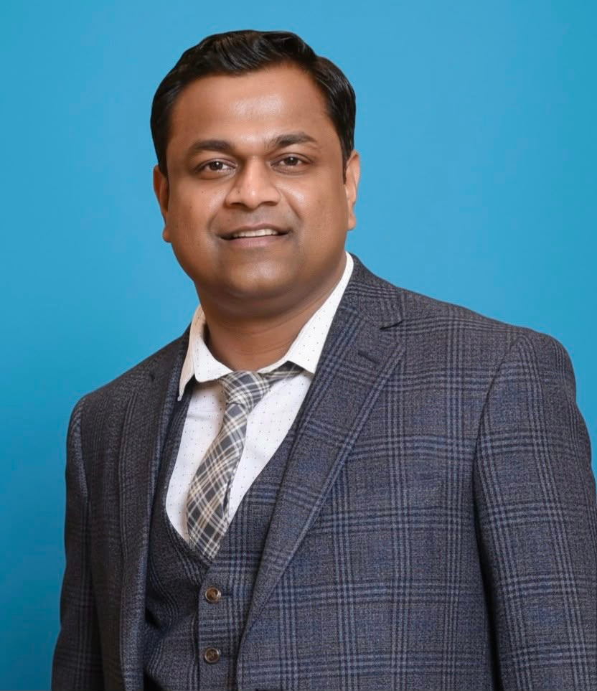

Young Rising Alumnus
SHASHANK GARG(BT/EC/2012)
Company Name - TCS UKI
Designation- Sr CRM Architect
Location -London, UK
Pass- out Year - 2012
PRIYA GOEL (BT/CS/2014)
Company Name: TSB BANK
Designation:LEAD ENGINEER FULL STACK
Location:LONDON ,UK
Pass-out year- 2014

Slide 8
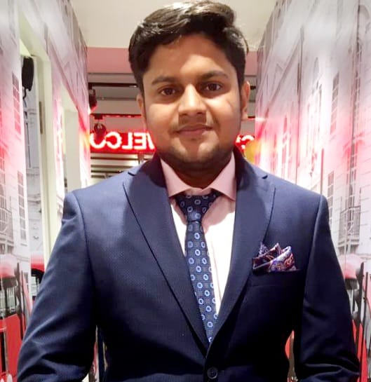
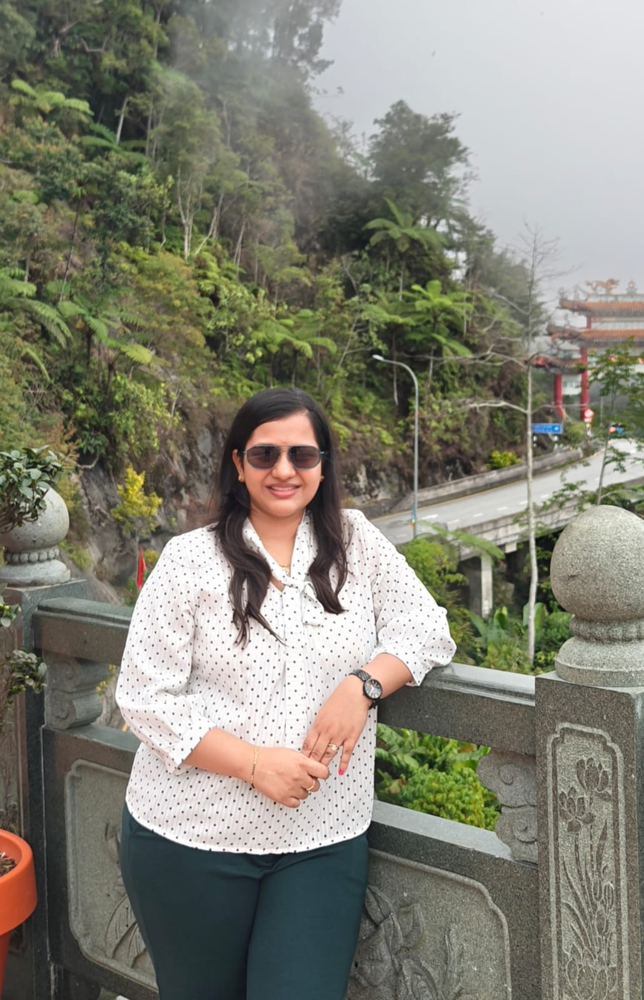
Young Rising Alumnus
MANISH KUMAR (BT/ME/2016)
Company Name - STAR WIRE INDIA LIMITED
Designation- Quality Assurance Manager
Location - Faridabad
Pass- out Year - 2016
MANSI GUPTA (BT/EC/2014) Company Name: Nagarro
Designation: Associate staff engineer
Location: Noida
Pass-out year- 2014

Slide 9
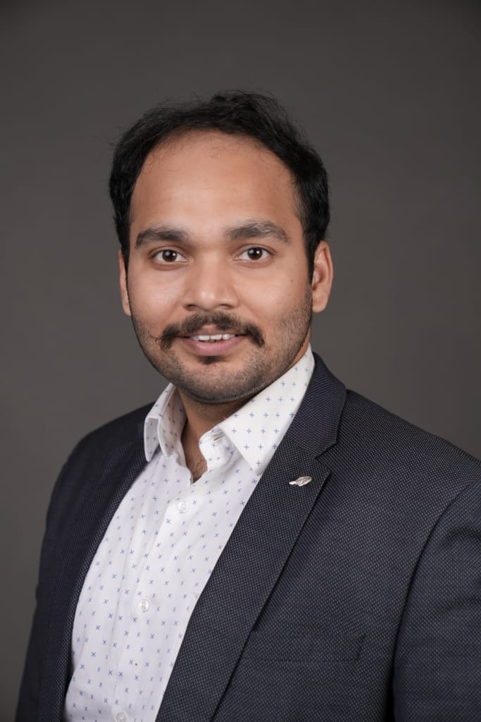
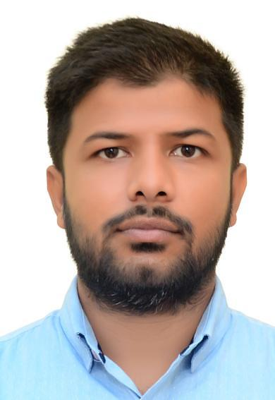
Young Rising Alumnus
ASISH KUMAR (BT/EC/2017)
Company Name - DELOITTE
Designation- MANAGER
Location - NOIDA
Pass- out Year - 2017
ABHINAV TYAGI (BT/EC/2016)
Company Name -Pet stream inc
Designation- Senior service engineer
Location - NOIDA
Pass- out Year - 2016

Slide 10
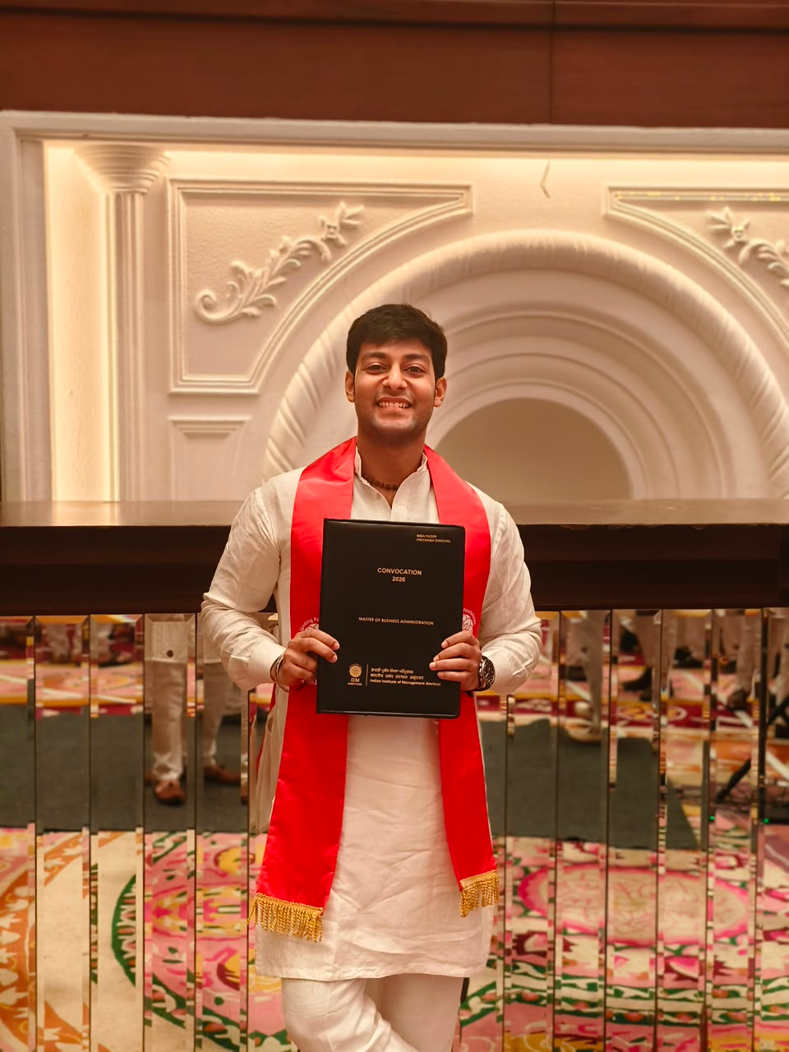
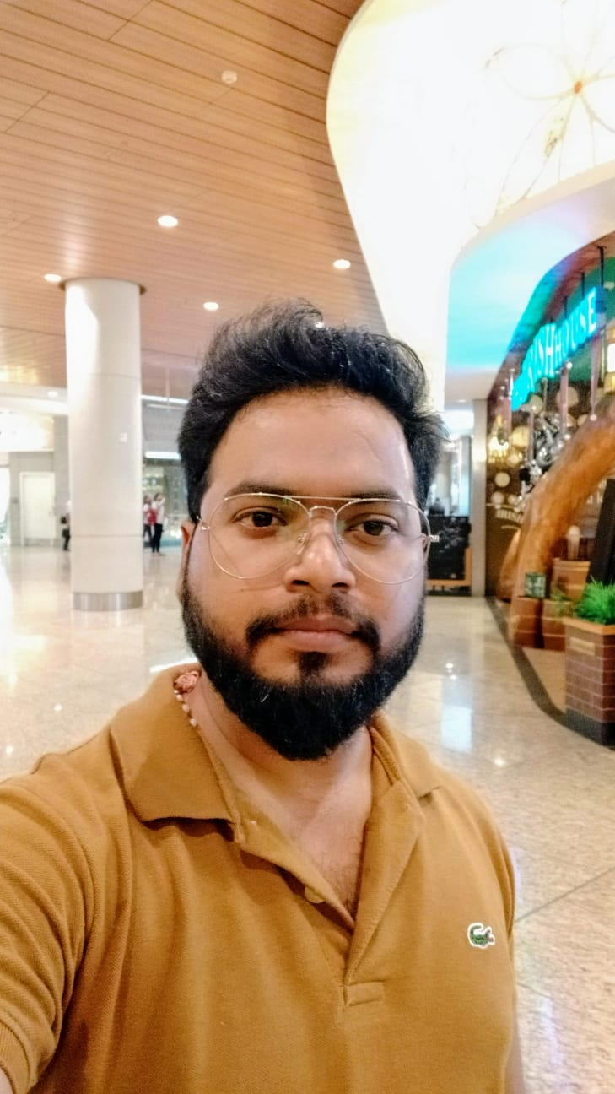
Young Rising Alumnus
PRIYANSH (BT/CS/2020)
* Company Name - Cognizant
* Designation - Senior Associate-Projects
* Location - Noida
* Pass-out year - 2020
PRAVEEN DWIVEDI (BT/EC/2012)
Company Name - ORACLE
* Designation - Principal Engineer (ORMB SME)
* Location - Noida
* Pass-out Year- 2012

Slide 11
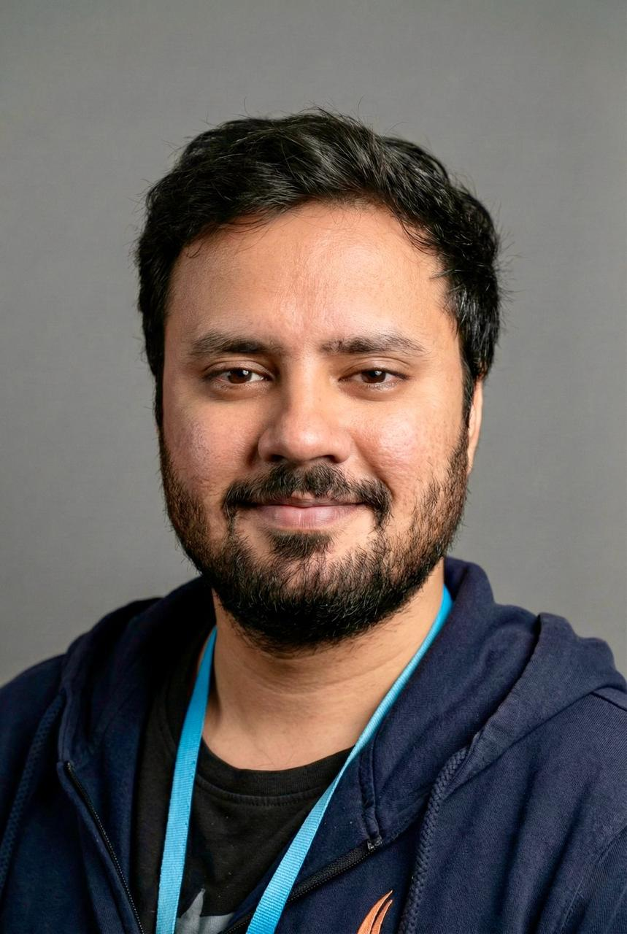
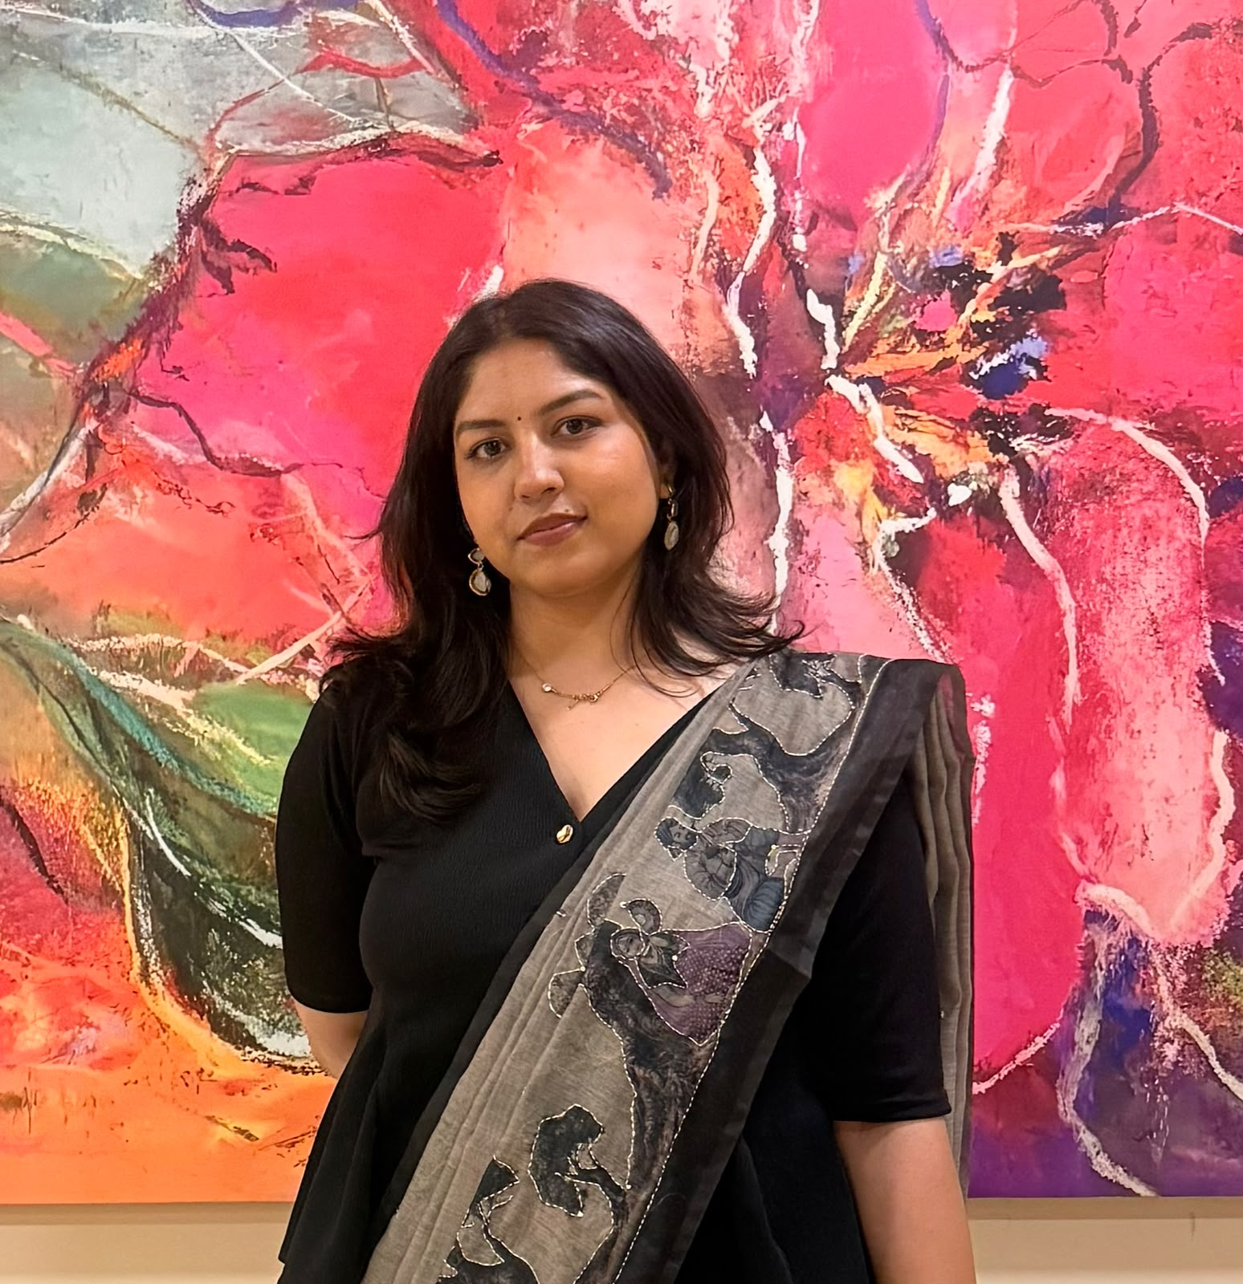
Young Rising Alumnus
Mr. SAJJAN (BT/CSE/2021)
Company- Amazon
Designation- SDE1
Pass-out year- 2021
Ms. NEHA (BT/EC/2017)
Cadence Design Systems
Lead product Validation Engineer
Noida
2017 pass-out

Slide 12
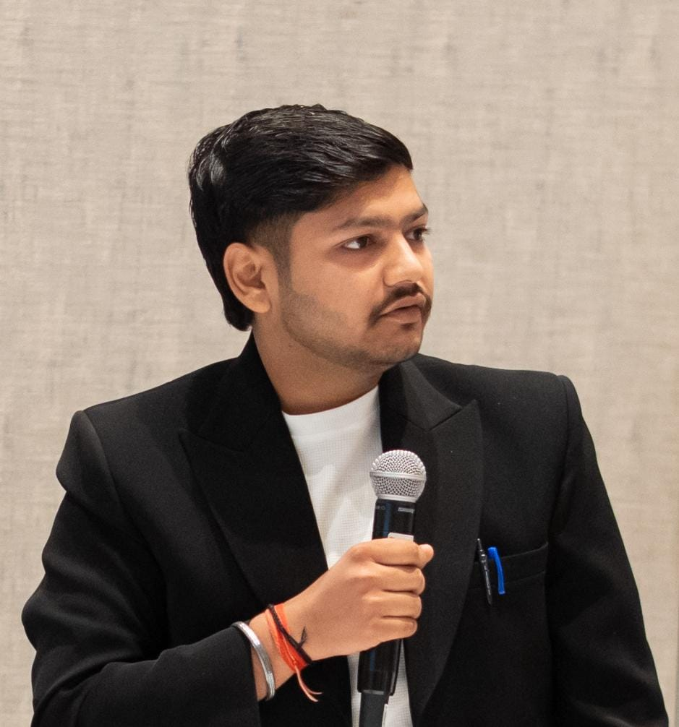
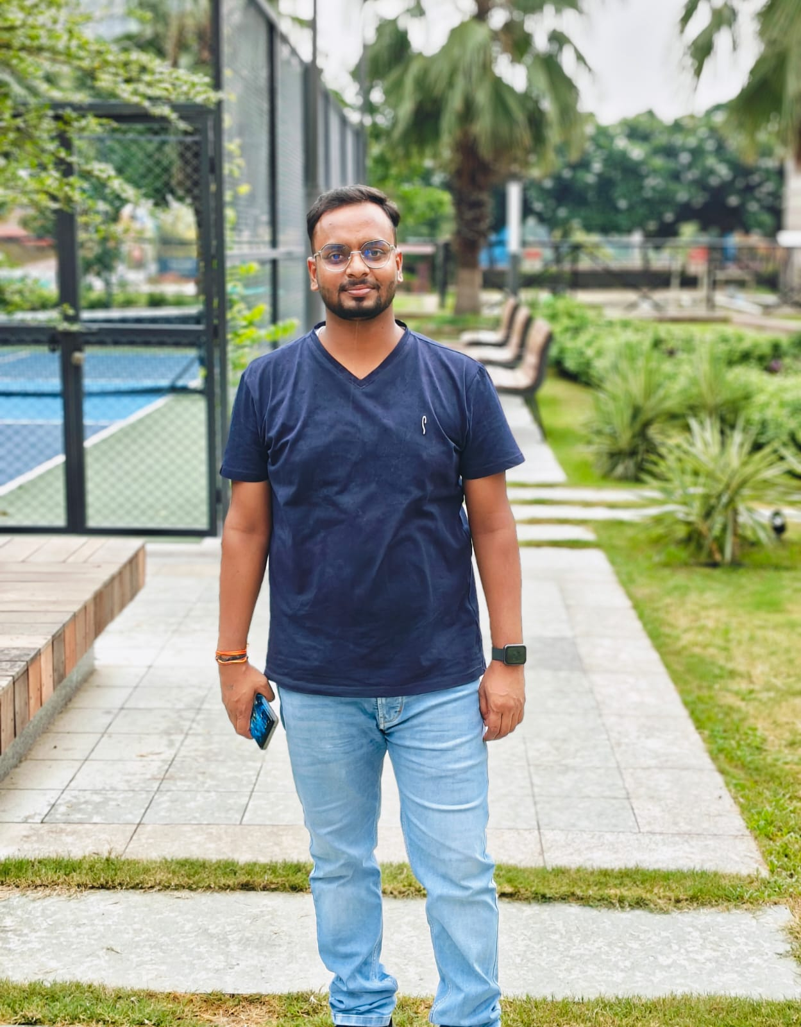
Young Rising Alumnus
Mr. DHRUV SINGHAL(BT/CSE/2025)
INTERNATIONAL CENTRE OF EXCELLENCE FOR DAMS , IIT ROORKEE
PROJECT ASSOCIATE
IIT ROORKEE, UTTARAKHAND
2025
MR. VIPIN (BT/IT/2018)
Company:- Businessnext
Designation :- Software Developer
Location :- Noida Sector 62

Slide 13
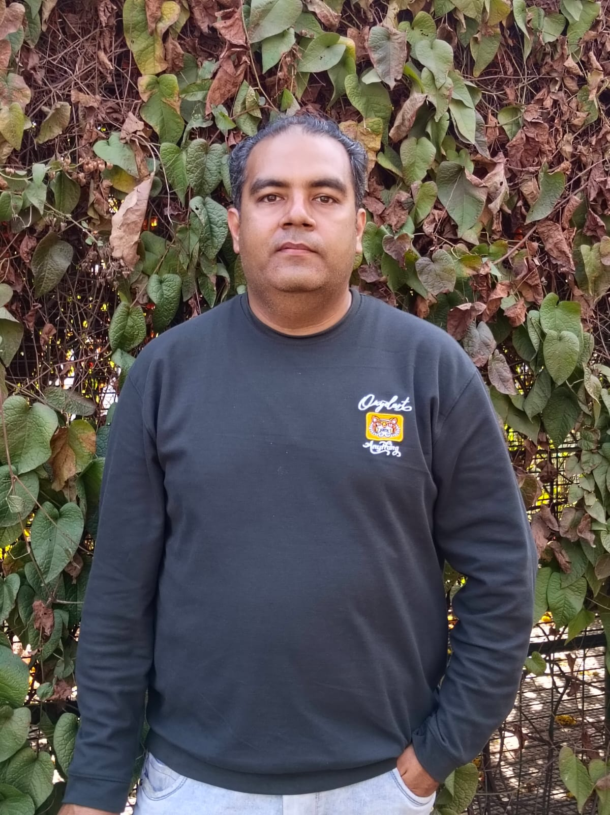
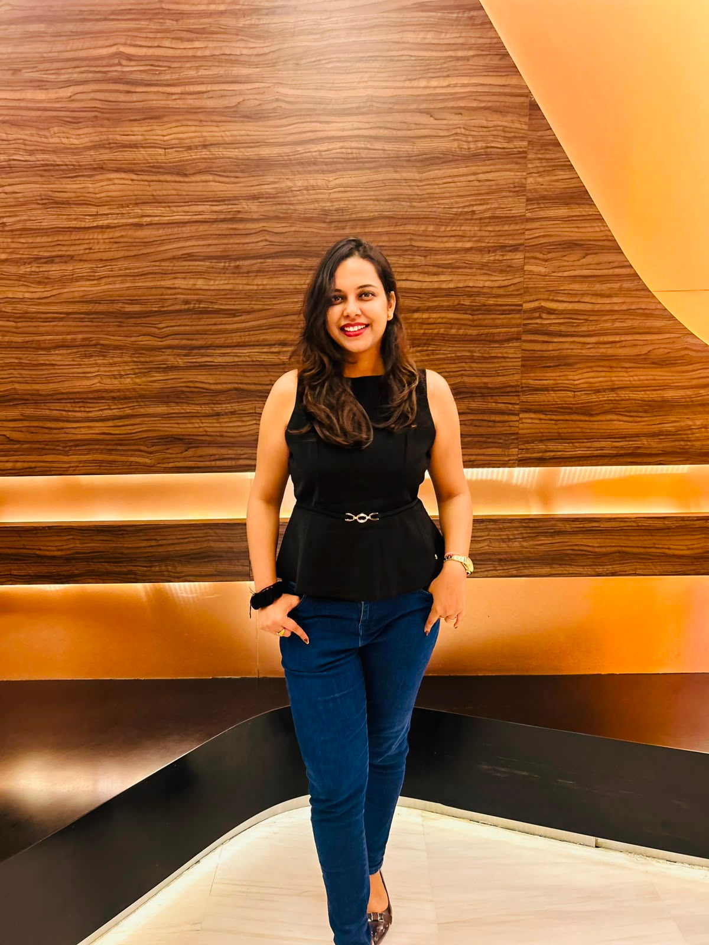
Young Rising Alumnus
Mr. ASHUTOSH VATS (BT/CSE/2007)
* Company Name- Zimo technologies pvt LTD , Mohali
* Designation- Project Lead Engineer
* Location- Mohali Punjab
* Pass-out Year-2007
MS. SHIVANGI GUPTA (BT/CSE/2017)
* Company Name - Deloitte
* Designation - Consultant
* Location - Bangalore
* Pass-out Year - 2017

Slide 14
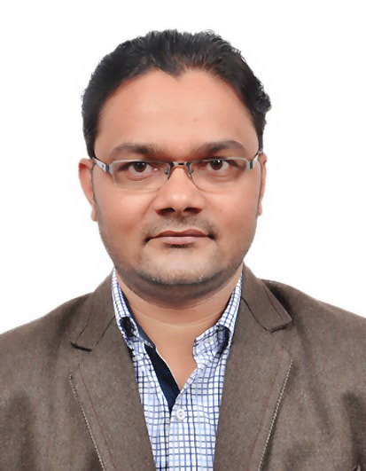
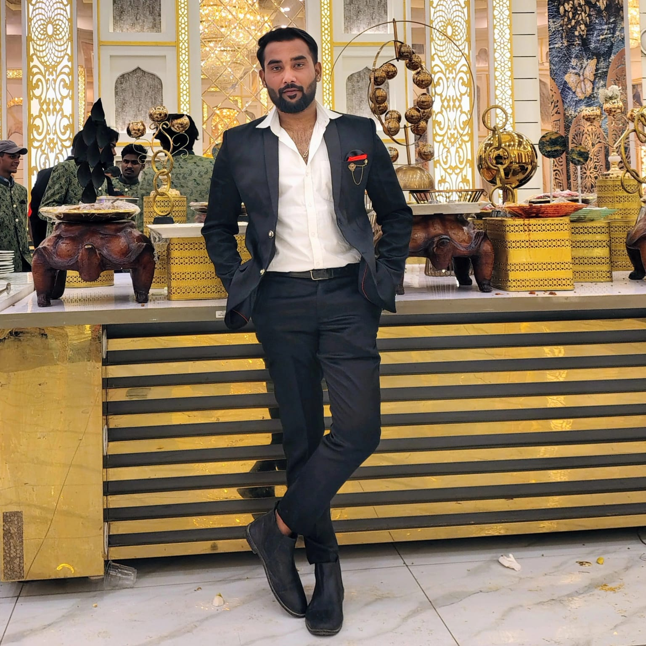
Young Rising Alumnus
Mr. SANJEEV KUMAR (BT/IT/2004)
* * Company Name : Ericsson Global Ltd.
* Designation : Technical Project Manager
* Location : Gurgaon
* Pass-out Year : 2004
MR. TUSHAR (BT/EC/2023)
* * Company Name - Easemytrip.com
* Designation - Devops engineer
* Location - Noida
* Pass-out Year - 2019- 2023

Slide 15
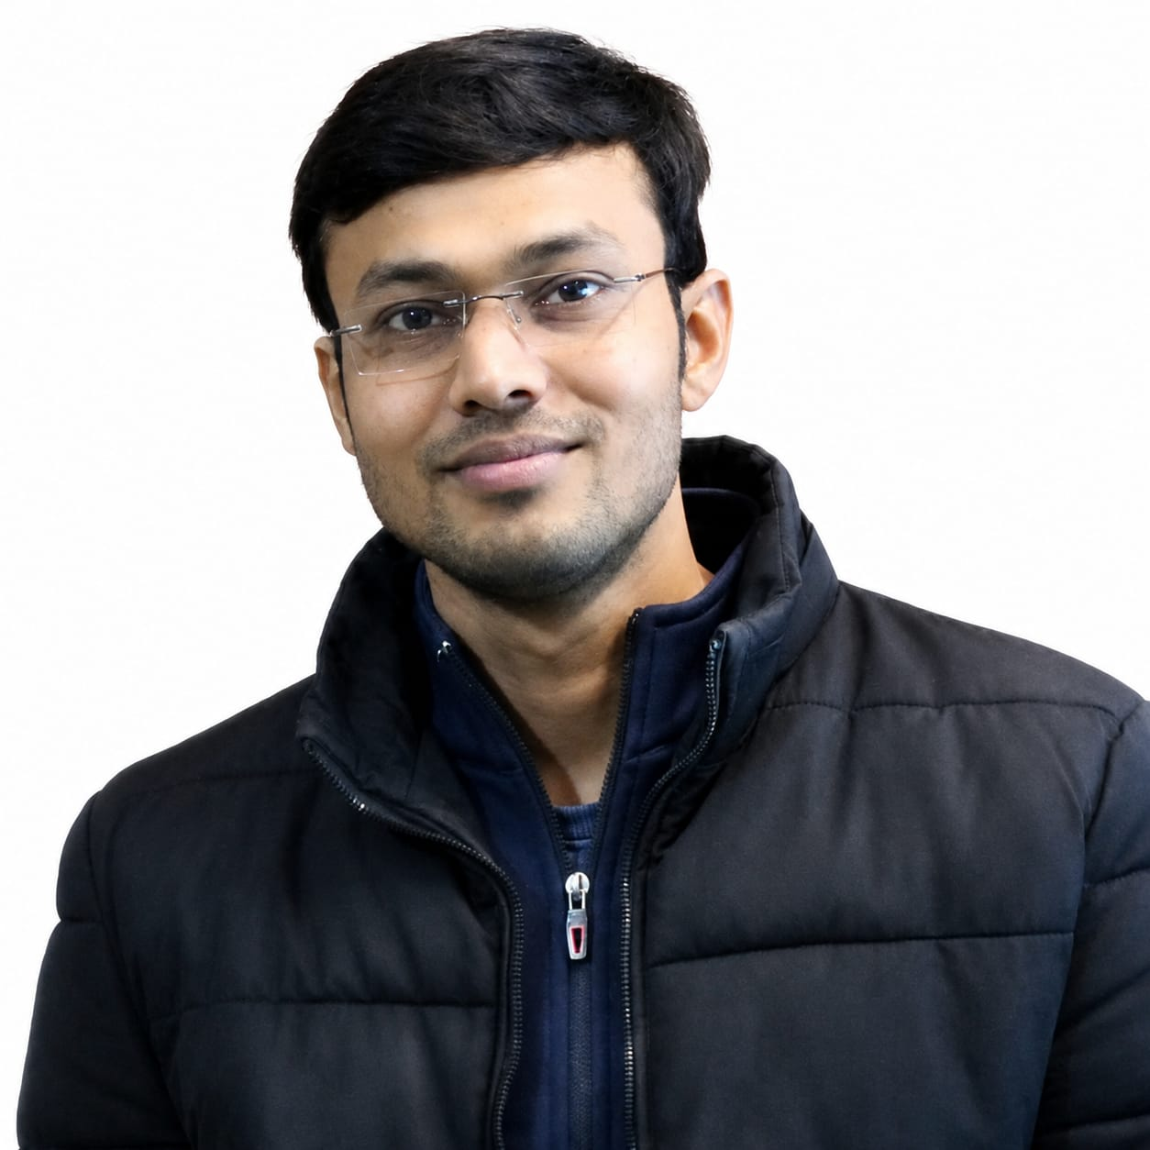
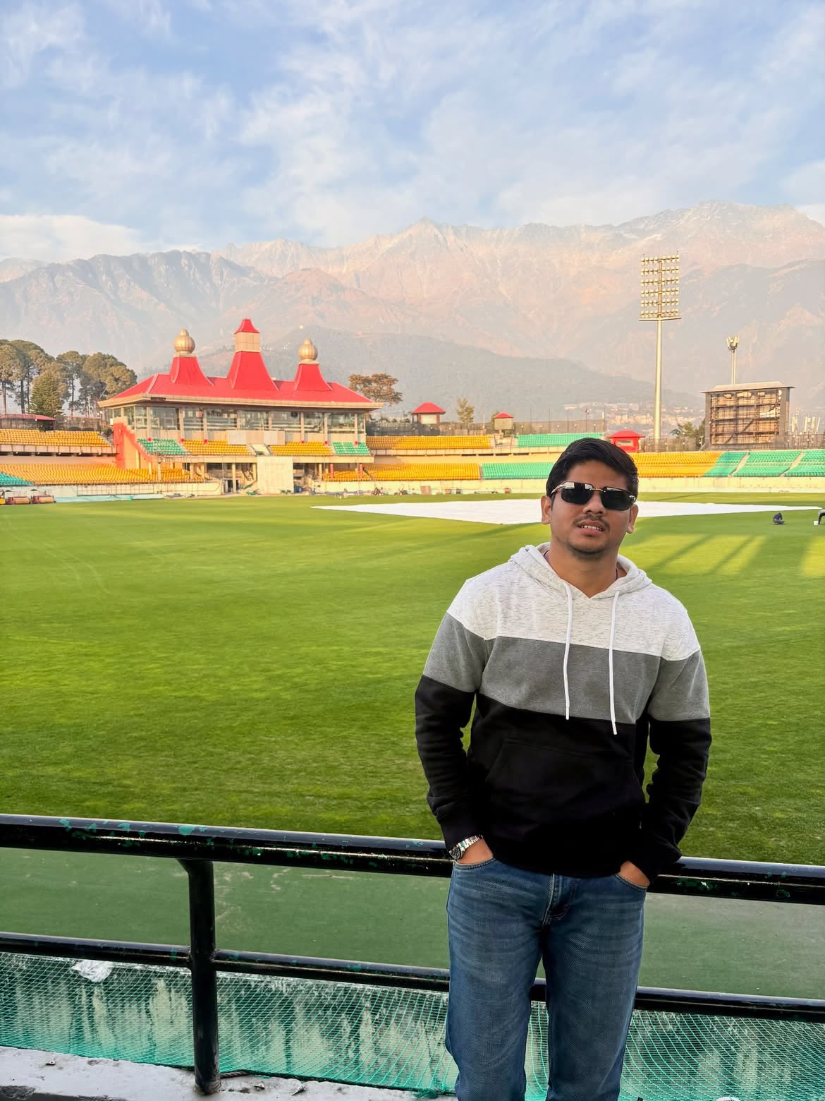
Young Rising Alumnus
Mr. RAHUL GOEL (BT/EC/2016)
Company Name: Ericsson Global
Designation: Senior Network Engineer
Location: Noida
Passout Year: 2016
MR. PRASHANT (BT/IT/2020)
*Company Name: Par Technology
Designation: Senior Data Engineer
Location: Gurgaon
Pass-out year: 2020

Slide 16
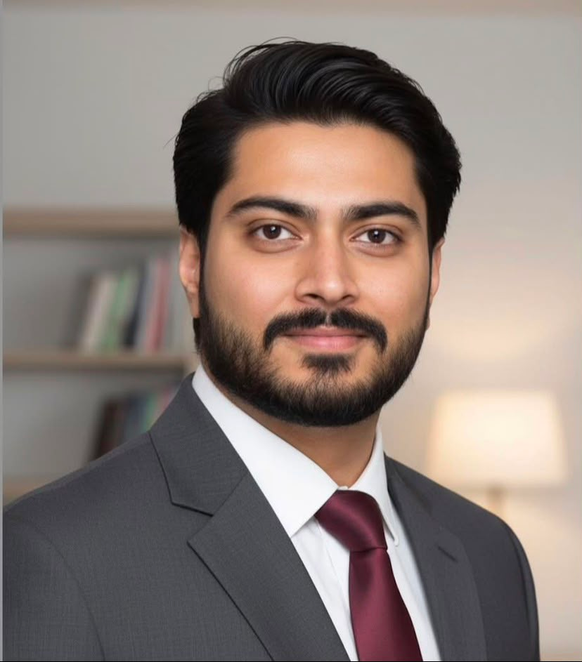
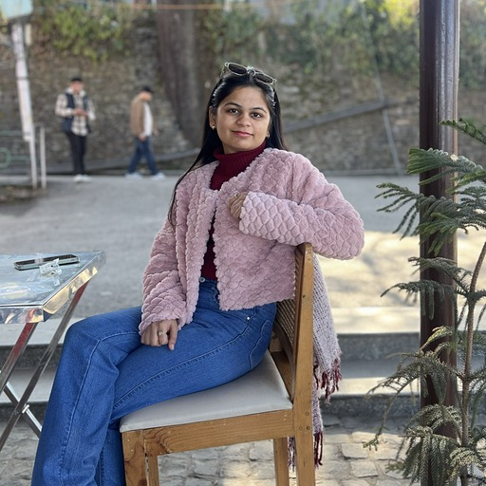
Young Rising Alumnus
Mr. ANKUSH RAJ TYAGI (BT/EC/2015)
Company Name: Zyra Living Design & Implementation LLC
Designation: Project Manager
Location: Dubai, UAE
Pass-out Year: 2015
MS. PRIYANSHI (BT/CS/2021)
*Company Name: Par Technology
Designation: Software Engineer II
Location: Gurgaon
Pass-out year: 2021

Slide 17
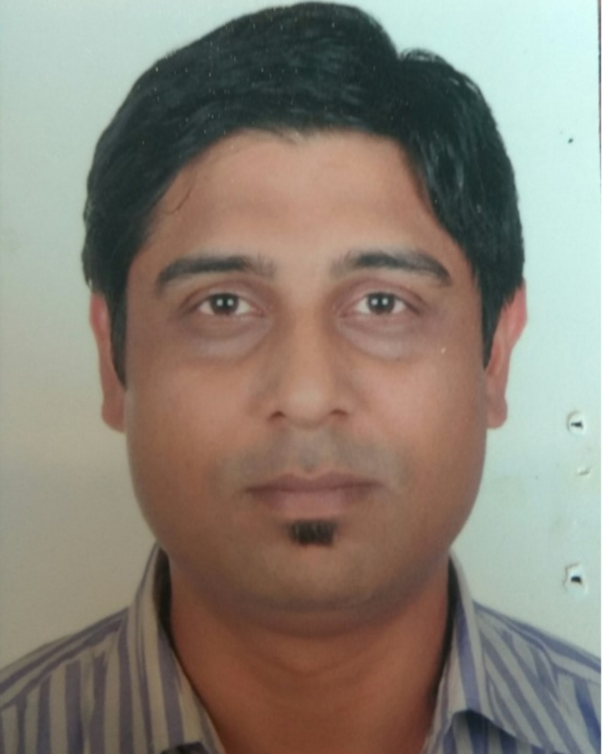
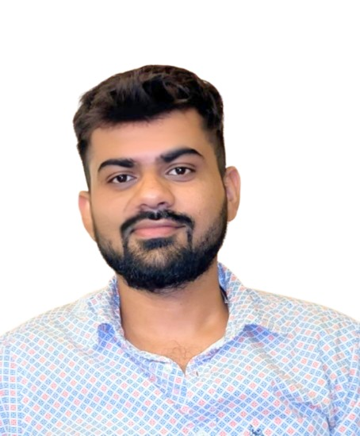
Young Rising Alumnus
Mr. ASHUTOSH VATS (BT/EC/2007)
Name--> Ashutosh Vats
Company Name--> Ericsson Global India Pvt. Ltd.
Designation--> Senior Engineer
Location--> Noida, U.P
Pass-out Year--> 2007
MR. ANIKET TYAGI (BT/CS/2021)
*Company Name: Sopra Steria
Designation: Module Lead
Location: Noida
Pass-out year: 2021

Slide 18
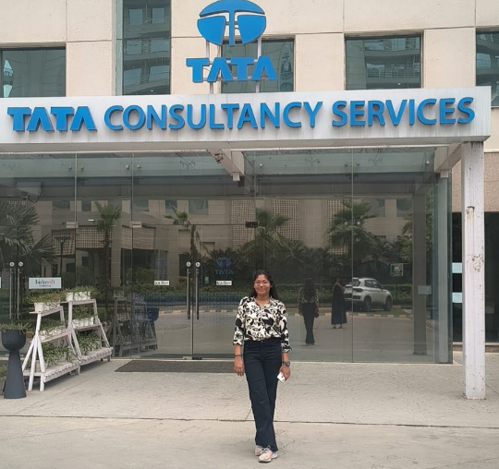
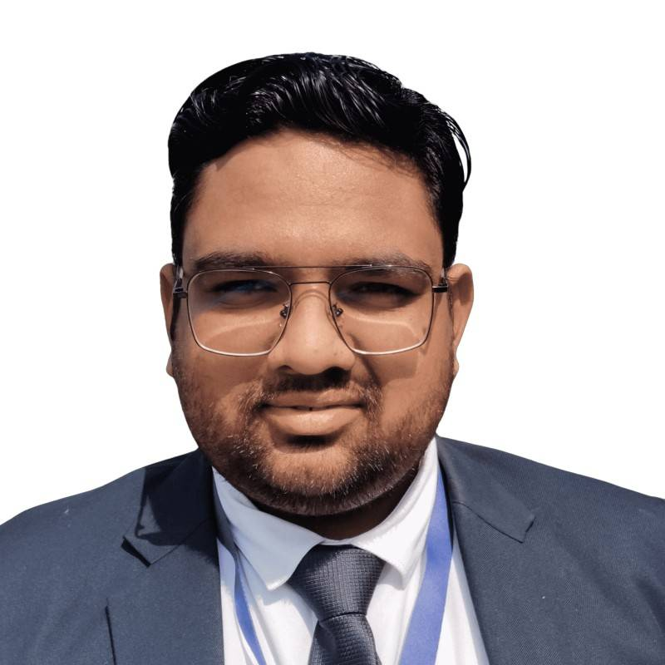
Young Rising Alumnus
MS. Priya Gupta(BT/CS/2026)
Company Name--> TCS
Designation--> Systems Engineer
Location--> Noida, U.P
Pass-out Year--> 2026
MR. PRATEEK SARASWAT (BT/CS/2024)
** Company Name : Media Mantra Global
* Designation : Analytics Manager
* Location : Gurugram
* Pass-out Year : 2024

Slide 19
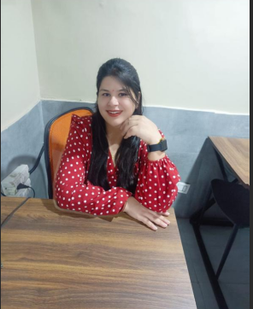
Young Rising Alumnus
MS.SHIPRA SHARMA (BT/EC/2017)
Company Name--> Shipra Sharma
Imarticus Learning
Designation--> Senior Quality Assurance Engineer
Location--> Noida, U.P
Pass-out Year--> 2017
MR. PRATEEK SARASWAT (BT/CS/2024)
** Company Name : Media Mantra Global
* Designation : Analytics Manager
* Location : Gurugram
* Pass-out Year : 2024

Slide 20
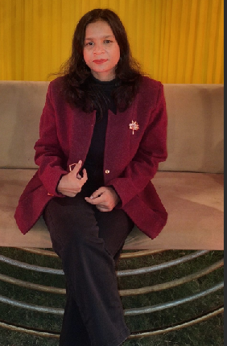
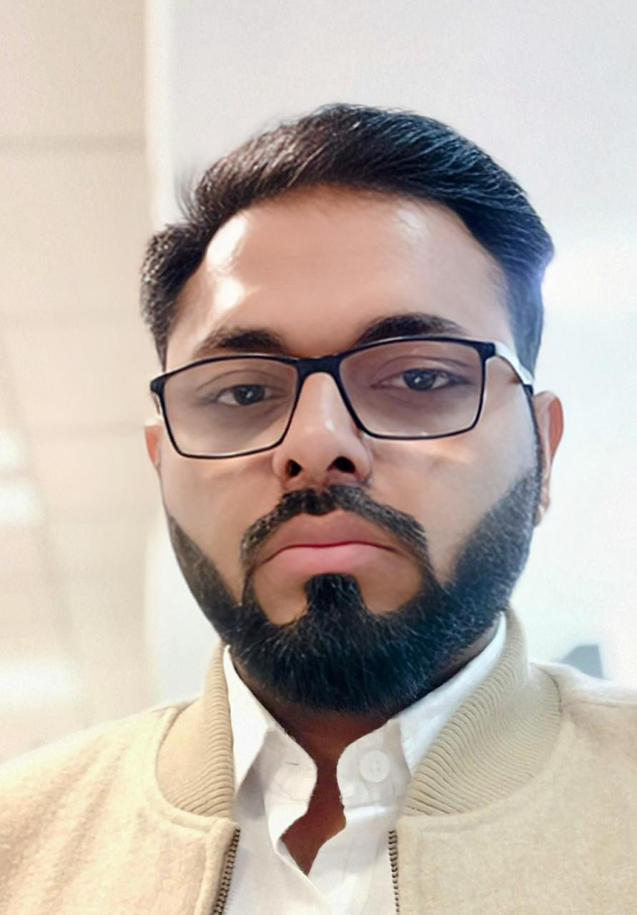
Young Rising Alumnus
MS.SHUBHANGI JAIN (BT/CS/2024)
Company name - Austere system limited
Designation - Software developer
Passout year - 2024
Location - Gurugram
MR. Saurabh Kumar Garg
(BT/EC/2006)
Company:HCL Tech
Designation:Group Project Manager
Location:Noida
Passing Year: 2006

Slide 21
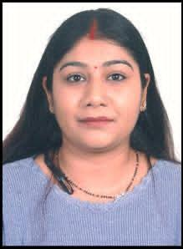
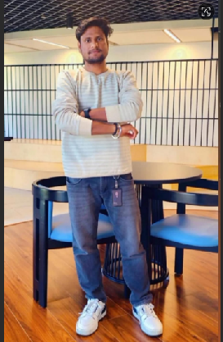
Young Rising Alumnus
MS.ADITI VERMA (BT/IT/2018)
Company name : Genpact
Designation: Sr. Software Tester
Location: Gurugram
Pass out Year : 2018
MR. ATUL (BT/CS/2021)
Company Name: Digantara Research & Technology, contracted with ISTRAC (ISRO), LRDE (DRDO), Air Force, DSA, NTRO and build their own satellites (and i personally working with ISTRAC and
LRDE)
Designation: SDE-2
Location: Bangalore
Pass-out Year: 2021

Slide 22
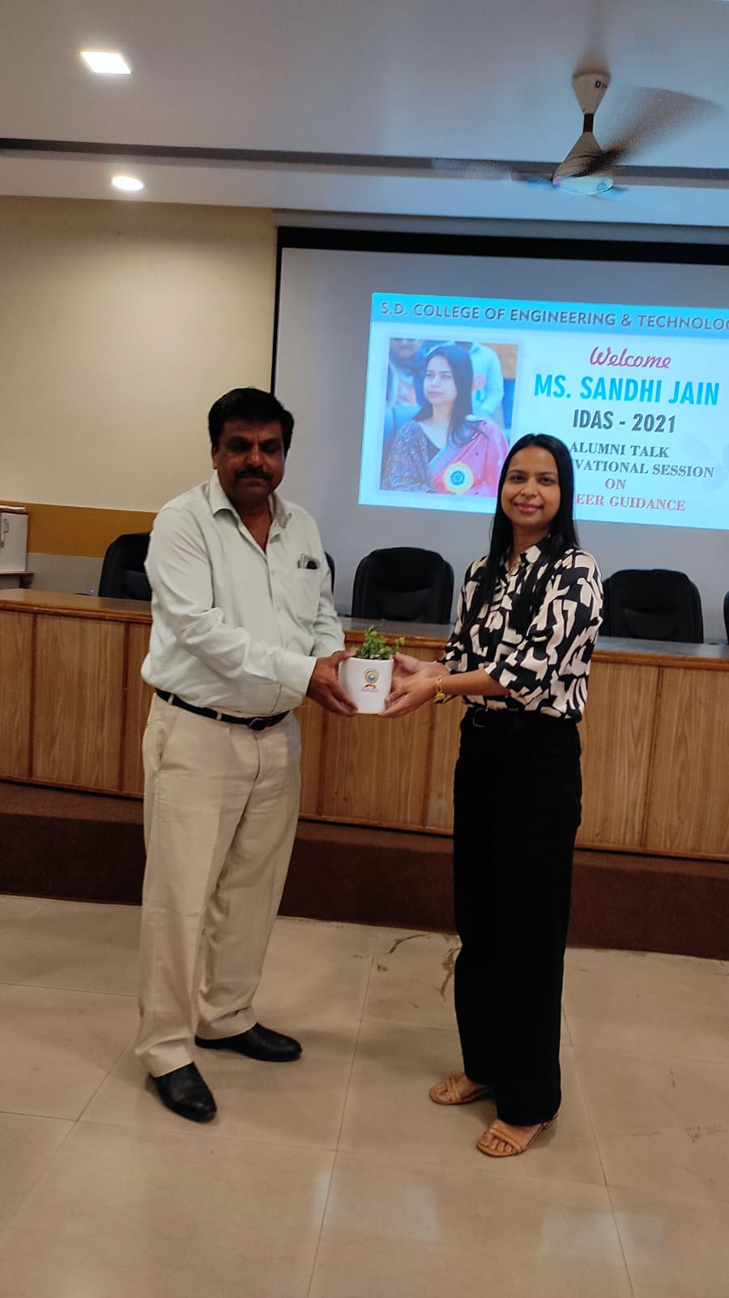
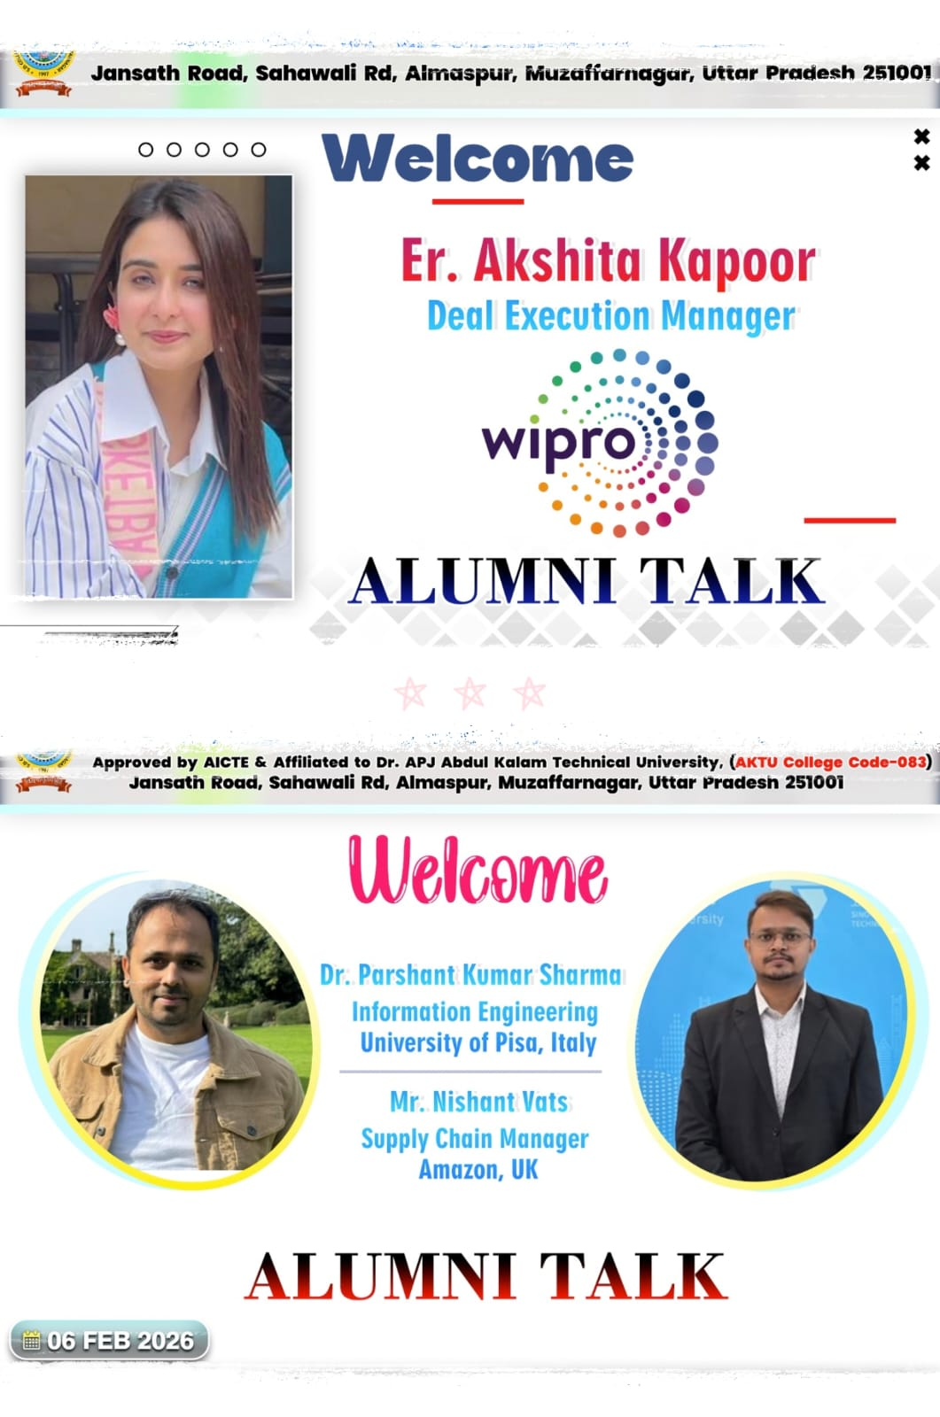
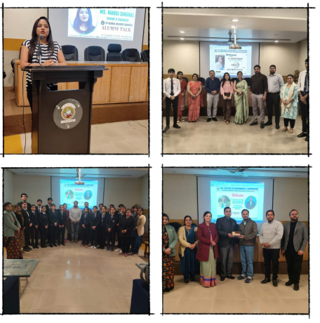
ALUMNI TALKS IN COLLEGE

Slide 23

Improve chapter integration and activities
Chapters allow the face to face connect with the alumni at the same location. There are a number of events that happen and create a good feeling and bonding.
  Chapter activities increase and improve Chapter Accreditation
    Cross chapter events, invitations and participations
.
      Communication groups within the chapter and across the
chapters.
.
Almost all chapters have the regular family sessions. Active chapters include those in Singapore, London, Silicon Valley, East coast, Delhi, Outer Delhi, Bangalore, Mumbai, Pune, Hyderabad, Jaipur, Canada. There are groups which are active in Gujarat , Midwest, Los Angeles , Boston.

Slide 24
Alumni Association invites its alums to engage
and contribute in various ways:
Volunteer and be part of the standing committee
Assist in industry connect
Involvement with the incubation centre
Mentor , Coach , Invest students or incubatees
Strategic input and feedback
Be part of the SDCET development foundation
Rejuvenate or lead the chapter or cross chapter initiatives

Slide 25
Thank you
44

